Slide 1
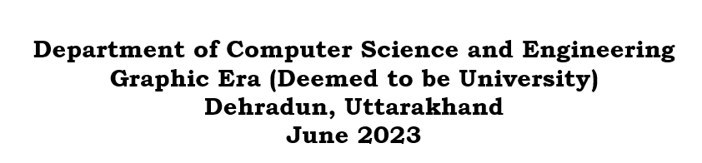

MOTION GESTURE RECOGNITION
Made By- Ruudra Amola
Univ Roll No- 2016972
Mentor- Dr. Parul Madan
(Assistant Professor)

Slide 2
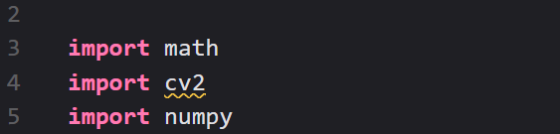
INTRODUCTION
Problem Statement:
The main purpose of this project is to build an application of motion gesture recognition technology. Further implemented few basic hand gestures using Open CV in Python.
Software and Tools/modules used:
Language Used- Python (Version 3.11.1)
Python is a high-level, general-purpose programming language that is widely used for web development, data analysis, artificial intelligence, scientific computing, and many other applications.
Modules Used-

Slide 3
Cv2 module: The cv2 module is a part of the Python programming language's OpenCV library ("Open Computer Vision"), which is a collection of tools for working with visual data.
NumPy module: With NumPy, you can easily create arrays, which is a data structure that allows you to store multiple values in a single variable.
math module: The math module in Python is a built-in module that provides a set of mathematical functions and constants. It is a standard module. The math module includes functions for performing basic mathematical operations.
IDE used- VS Code (Version 1.8)
Visual Studio Code (VS Code) is a free and open-source code editor developed by Microsoft for Windows, Linux, and macOS. It is built on top of the open-source Monaco editor. VS Code is a powerful code editor that can be used for a wide variety of programming languages, including JavaScript, TypeScript, Python, C++, C#, Java, and PHP. It includes several features that make it a popular choice for developers.

Slide 4
METHODOLOGY
This project mainly focuses on practical implementation of motion gesture recognition technology to track hand movement and recognize a gesture in front of the webcam of a specific hand shape and detects it.
It has a frame box which appears once the open CV module invokes the system webcam and then it recognizes the hand gesture from the web cam. The main library used in the project is OpenCV.
Open-CV: The concept of OpenCV was put forth by Gary Bradski which had the ability to perform on multi-level framework. OpenCV has several significant abilities as well as utilities which appears from the outset. The OpenCV helps in recognizing the frontal face of the person and creates XML documents for several areas such as the parts of the body.

Slide 5
Brief Understanding of the Code:-
First, we capture the video and then define the region of interest. In the region of interest, it converts all the BGR colours to HSV colours.
The HSV (which stands for Hue Saturation Value) scale provides a numerical readout of your image that corresponds to the color names contained therein.
After that I have defined the skin colour range in HSV anything that is of skin colour will be taken as one or white and any other colour will be taken as zero or black. Then I have just dilated and blurred the image to decrease any amount of noise present in the image.

Slide 6
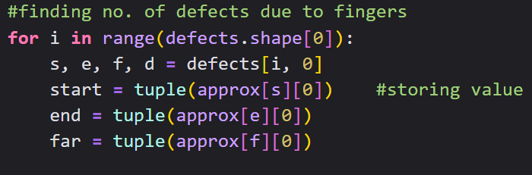
After that defects in convex hull are to be found. Defects are regions that are not covered by the hand in the convex hull. Any deviation of the contour from the convex hull is known as convexity defect. OpenCV comes with a ready-made function to find this, cv2.convexityDefects(). It takes as input the contour and corresponding hull indices and returns an array containing convexity defects as output. It returns an array where each row contains these values - [ start point, end point, farthest point, approximate distance to farthest point ].

Slide 7
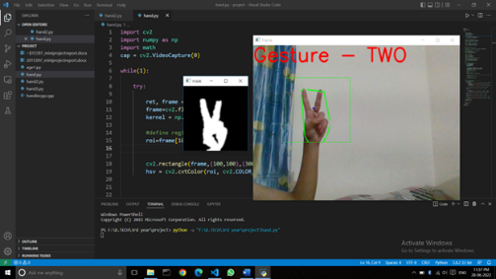
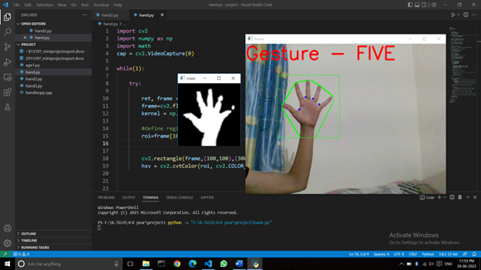
RESULTS AND DISCUSSIONS
The system is built to recognize a total of 8 hand gestures based on finger gap and angles out of which 2 have been displayed above in the screen shots.

Slide 8
The above screenshots show that the gestures are shown through the webcam using the hands and those gestures are recognized showing specified values in the window.
The main recognition part is done based on the area of the hand contour that appears in the region of interest and the angle between the fingers.
Motion gesture recognition technology is a rapidly evolving field with a wide range of potential applications. As technology continues to develop, we are likely to see even more innovative and exciting applications for this technology in the future.

Slide 9
CONCLUSION
Developing recognition systems which are efficient for working under different conditions is tough, but it is more possible because these hurdles exist in the real-world environment. Hand gesture recognition is very significant for human-computer interaction. Gesture recognition appears in many real-life applications, e.g., gesture-based gaming control, medical applications, controlling home appliances, in IoT devices, sign language translations and many more.
Advantages:
The advantages of the face recognition system include more natural intuitive interaction, faster task processing, automation of the identity, breach of privacy, enhanced security, more flexibility in systems and many more in day-to-day life.
Disadvantages:
Some of the disadvantages are inaccuracy due to the varied working environments of the user, motion gesture systems can be sensitive to noise and other environmental factors too. The meaning of gestures can be ambiguous. This can make it difficult for gesture recognition systems to interpret the meaning of gestures in a meaningful way.

Slide 10

THANK YOU!

